Slide 1
I want to traverse this graph… How? Dylan Blecher, COMP2521
I want to start from node 0 and then see all nodes from there.
In trees, we could go left or right. What now?
From the start node, go to all neighbours, from smallest to largest. Repeat from neighbours.

Slide 2
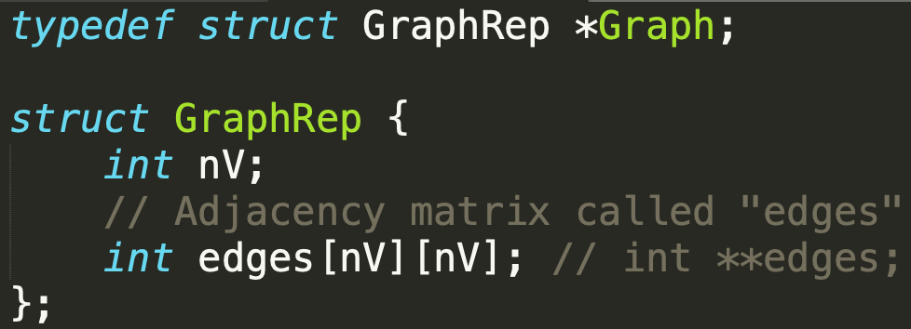
Example Graph Structure

Slide 3
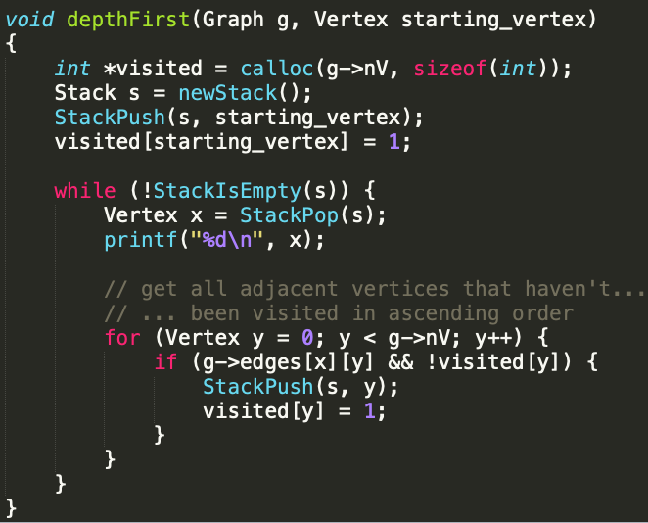
Depth First Search (DFS)
v = 0 (start)
visited:
Stack s:
Visiting order: 0 7 4 3 6 5 2 1
Index | 0 | 1 | 2 | 3 | 4 | 5 | 6 | 7
Seen (0 or 1) | 1 | 1 | 1 | 1 | 1 | 1 | 1 | 1
g

Slide 4
Depth First Search (DFS)
0
1 2 5 6 7
4
3
g

Slide 5
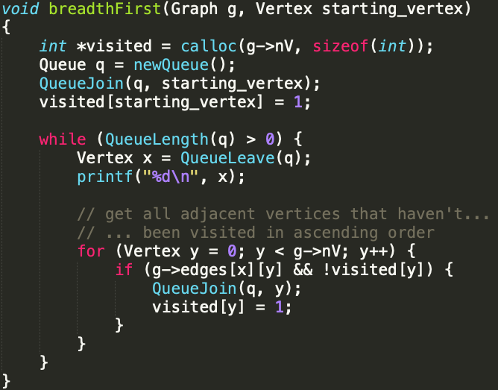
Breadth First Search (BFS)
v = 0 (start)
visited:
Queue q:
Visiting order:
Index | 0 | 1 | 2 | 3 | 4 | 5 | 6 | 7
Seen (0 or 1) | 0 | 0 | 0 | 0 | 0 | 0 | 0 | 0
g

Slide 6
Breadth First Search (BFS)
0
1 2 5 6 7
3 4
g

Slide 7
Hamilton/Euler Path/Tour
Hamilton: each vertex
Euler: each edge
Path: visits each exactly once
Tour: visits each exactly once and returns to start point

Slide 8
Recursive DFS
0 → 1 → 7 → 4 → 3 → 5 → 6 → 2

